Slide 1
date-fns library
Notes:
Typescript popularity is exploding for many good reasons.
It is the superset of javascript helps you write better code faster and compiles to javascript that will run in any modern web browsers

Slide 2
Introduction
Type of date & time manipulation
Installation
Before date-fns library
Reasons to choose date-fns over moment js?
Functions
Demo (Calendar)
References
Notes:
Talk about the objectives => cover good to know details about typescript, introductory session

Slide 3
01
Introduction

Slide 4
Introduction
Definition:
date-fns provides the most comprehensive, yet simple and consistent toolset for manipulating JavaScript dates^{[1]}.
It has 200+ functions.
Official website: https://date-fns.org/
Latest version: v3.0.6

Slide 5
02
Type of date & time manipulation

Slide 6
Type of date & time manipulation
Parsing – parseISO - If we have a string value and returning a date value, that is called parsing.
Formatting – YYYY-MM-DD - modifying the date formats.
Transformation – add 2 years.
Difference – diff in months between two instances
Comparisons – Is one instance before another instance.

Slide 7
03
Installation

Slide 8
Installation
The library is available as an npm package^{[1]}.
To install the package, run:
npm install date-fns --save
or
yarn add date-fns
How to start?
import { format } from "date-fns";

Slide 9
04
Before date-fns library

Slide 10
Before date-fns library
Momentjs is a most useful javascript date and time library in React.
This library is now deprecated
Another alternative for momentjs^{[2]}
Luxon
day.js
date-fns - popular
js-joda

Slide 11
05
Reasons to choose date-fns over moment js?

Slide 12
Reasons to choose date-fns over moment js?
Another alternative for momentjs
Function per file - No need to import entire package.
Support more than 50 locals
Date-fns are immutable. – It creates a new objects always.
It is fast & less size - Only importing what is needed. In momento, we must import whole package. If we want to import format function, then must import only format function. It reduces the application packaging size.

Slide 13
06
Functions

Slide 14
Functions
Will see the common constants and some useful functions like daysInWeek, endOfMonth, getDay, isEqual, isSameDay, isSameMonth, isToday, parse, add, format etc. from official website.
Website: https://date-fns.org/

Slide 15
07
Demo

Slide 16
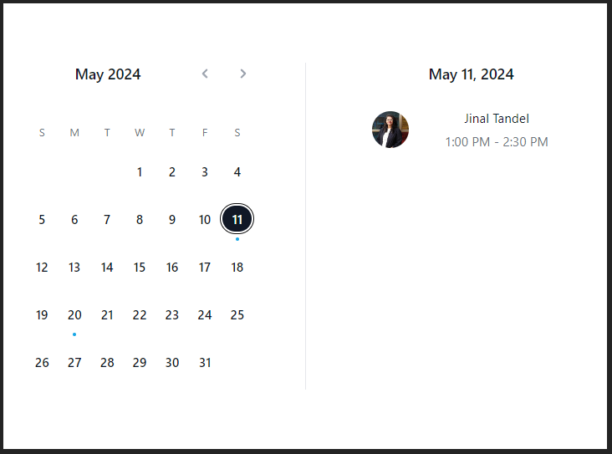
Demo
Made a calendar using date-fns functions.
Output screenshot:
Figure 1: calendar using date-fns functions

Slide 17
08
References

Slide 18
Refences
https://date-fns.org/docs/Getting-Started
https://www.youtube.com/watch?v=4ygUUFjQVqA

Slide 19
Thank You

